Slide 1

DESIGN & IMPLEMENTATION OF AN AI - POWERED
TASK MANAGEMENT SYSTEM
(TASKWISE)
GROUP 4
ADEBOWALE OLUWASEGUN 22/0306
AGOHA EMMANUEL 22/0255
ANURIAM ISAAC 22/0004

Slide 2
Table of Contents
01
Introduction
02
Statement of the Problem
03
Aim and Objectives
04
Literature Review
05
Modelling and Design
06
Methodology
07
Conclusion

Slide 3
INTRODUCTION
Our increasing reliance on technology for effective time organization highlights a critical gap: while current systems offer basic recording, reminders, and progress tracking, they still demand high manual input and lack true automation.
Artificial Intelligence (AI) is the essential enabler to bridge this gap. By integrating core technologies like Natural Language Processing (NLP) and Voice Recognition, AI provides the capabilities to reason, learn, and respond intelligently. This allows users to communicate with the system naturally (e.g., "Remind me to attend a meeting at 10 a.m. every Monday"), transforming basic tools into genuinely automated and intelligent time management solutions.

Slide 4
Statement of the Problem
Primary Issue: Over-reliance on structured, manual input leads to inefficiency, time wastage, and cognitive overload.
Limitations
1. Existing apps struggle to interpret contextual language and
complex requests.
2. Lack of proactive automation in scheduling and task generation.
The Goal: A necessity for an automated, intelligent system to simplify task creation and boost productivity

Slide 5
Aim of the Project
Overall Aim: To design and implement a robust, AI powered task management system,
TASKWISE, that minimizes manual input and
maximizes task automation to significantly enhance
user productivity
Project Objectives
1.Design and Implement a user-friendly interface for seamless interaction.
2. Integrate AI/NLP to accurately process natural language (text/voice) into structured task data.
3. Develop Automated Scheduling and intelligent

Slide 6
Literature Review
Literature Review and Citation | Gaps and Limitations Identified | How TaskWise Aims to Fix That
However, despite these advancements, most available applications still depend heavily on manual input and provide limited automation features" (McKinsey, 2025) | Existing systems are heavily reliant on manual data entry and lack adequate automation. | TaskWise uses AI and Natural Language Processing (NLP) to automate task creation, scheduling, and progress tracking, minimizing manual input.
"Traditional productivity applications focus solely on end-user functionality, neglecting the need for administrative monitoring and data management" (Microsoft Research, 2025) | Neglect of administrative features, user management, and detailed analytics needed for scalability and organizational oversight | TaskWise includes a comprehensive Admin Panel for managing users, viewing deep productivity analytics, and handling premium access controls.
Users must frequently switch between applications to track deadlines, set reminders, and monitor progress, which leads to inefficiency and reduced productivity" (Kumar et al.,2025) | Fragmentation of features across multiple applications, causing inefficiency and a loss of focus | TaskWise is a unified platform that centralizes task management, notes, scheduling, reminders, and analytics in a single application.

Slide 7
Modelling and Design
System Architecture (High Level) | AI/NLP Model Design | Data Modeling (Key Entities)
Client Layer: User-friendly Mobile/Web Interface for natural language input. | Input Pipeline: Text/Voice Input \to Voice-to-Text \to NLP Parser. | Users: Manages login, profile, and personalization settings.
Application Layer: Core Task Engine, Business Logic, and API Interface. | Entity Extraction: The Parser extracts key components from natural language; Task Description, Due Date/Time, Recurrence Pattern, and Priority | Tasks: Core entity storing the processed task (Description, DueDate, Status, Priority).
AI Service Module: Dedicated service for Voice-to-Text conversion and NLP parsing | Example: "Book flight tickets next Friday" \to (Task: Book flight tickets, Due Date: Next Friday). | Task_Context: Stores AI generated metadata (e.g., AI_Parsed_Recurrence, NLP_Confidence_Score)

Slide 8
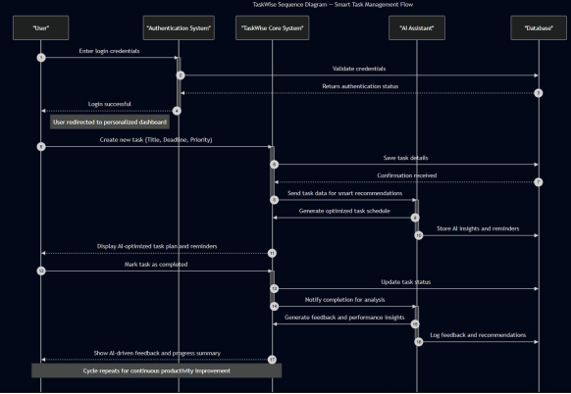

Slide 9
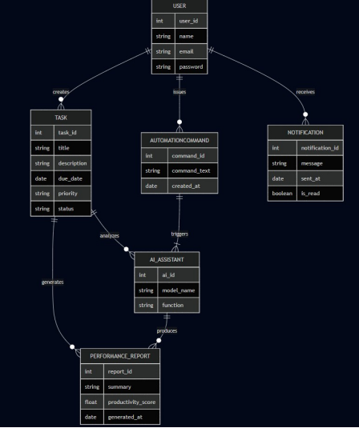

Slide 10
Methodology
Development Methodology
Testing &
Evaluation:
Analysis & Design:
Requirements definition and
system modeling (e.g., UML,
ER diagrams).
Verification of
functionality, usability, and
performance
Implementation:
Component development
(Frontend, Backend, and AI
Service).

Slide 11
Implementation Technology
Stack
Frontend (User Interface):
React and Tailwind - Focused on mobile-first and intuitive design.
Backend (Logic & API)
Firebase - Handles
task routing and service calls.
AI/NLP Engine:
Python libraries - Responsible for intelligent parsing
Database
Firestore - Chosen for
scalability and real-time
updates.

Slide 12
System Testing & Evaluation
Functionality Testing (Unit
Tests):
Verification of individual
components (e.g., task scheduling, reminder triggers).
NLP Accuracy:
Measure the percentage of
natural language commands
correctly converted into
structured task data.
UsabilityTesting:
Evaluate the user's
perception of ease-of-use and
time saved compared to
manual entry.

Slide 13
CONCLUSION
TASKWISE successfully addresses the critical limitations of manual task entry by utilizing a dedicated AI engine, significantly streamlining task management. Moving forward, our key areas of future work include integrating the system with popular calendar services (Google/Outlook), adding functionality for location-based reminders, and incorporating a Task Prioritization LLM to enhance organizational intelligence, which will be the focus of the post-presentation Questions and Answers session.

Slide 14
REFERENCES
In-Text Citation (from Table) | Full Reference
(McKinsey, 2025) | McKinsey, 2025
(Microsoft Research, 2025) | Microsoft Research, 2025
(Kumar et al., 2025) | Kumar et al., 2025

